Slide 1
Cybercrime

Slide 2
Cybercrime at a glance
Cybercrime
Illegal activity conducted on a computer
The computer is either a tool, or a target, or both
Cyberlaw
Area of law dedicated to cybercrime
Under developed or difficult to enforce in some countries
Ex: Love Bug Virus
Corrupting VB script that spread over email
Created in the Philippines

Slide 3
Types and tools of cybercrime
Viewing or purchasing illegal content/merchandise
Identity theft
Cyberbullying and cyberstalking
Phishing attacks
Pharming
Spam
Malware: malicious code or software designed to damage, disrupt, steal or negatively affect data, hosts, or networks
Botnets
Denial of Service (DOS) attacks

Slide 4
Phishing attacks
Phishing
An attempt to obtain sensitive information by disguising as a trustworthy entity
Often used get sensitive information or download malware
Example: click on a URL or open attachment
Spear Phishing: designed for a specific individual or organization
Whaling: targeted at executive-level individuals
How to protect yourself
Be suspicious of links and attachments
Check spelling of URLs and emails
Contact supposed source of email with a new email (don’t hit reply)
Don’t post personal data publicly

Slide 5
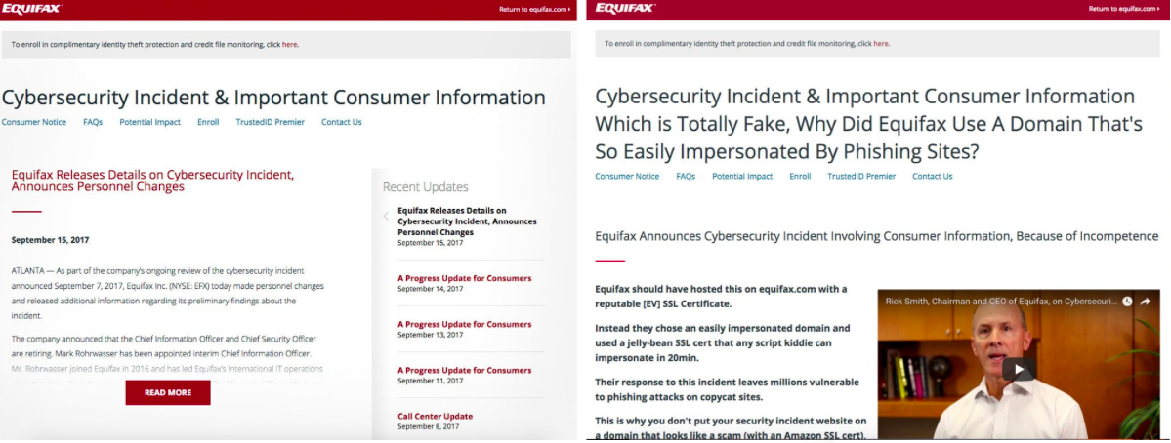
Pharming
Pharming
Fake website collects data you intended for real website
Can redirect requests for real website to the fake one
Example
Fake Equifax site linked to by Equifax
Real
Fake

Slide 6
Spam
Spam
Mass distribution of unsolicited messages
Often used for phishing
Vehicle for malware, scams, and fraud
85% of all email traffic in 2016
Majority comes from the US
Burdens communication service providers

Slide 7
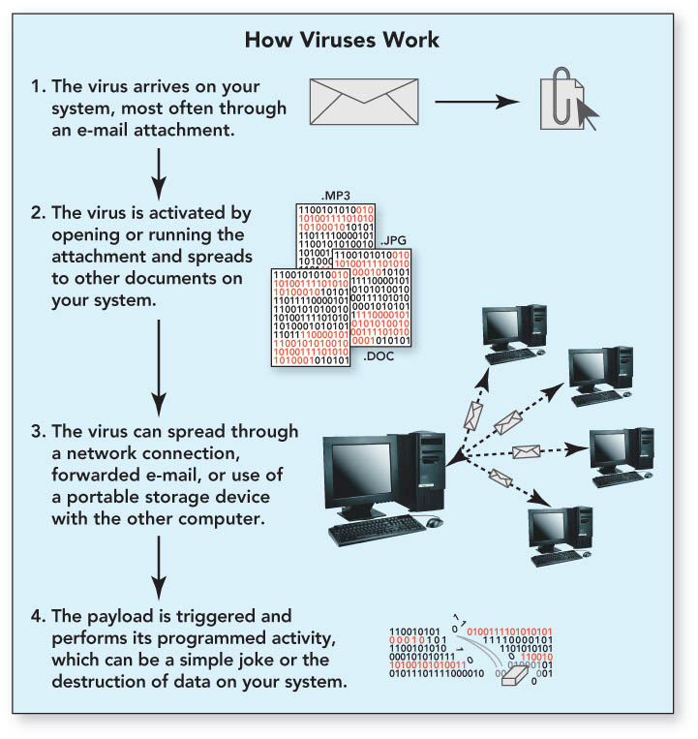
Malware: Computer Virus
Computer Virus
Software capable of replicating itself by modifying other programs and inserting its own code
Spread to other systems by people
Often used for ransom, monitoring, control, or corrupting data
Examples
Pikachu virus can delete all system files on restart
Shamoon uploads files to the attacker, erases them, and bricks the computer

Slide 8
Malware: Computer Worms
Computer Worm
Standalone program that replicates itself using a computer network
Doesn’t need human help to propogate
Often used for ransom, monitoring, control, or corrupting data
Examples
Stuxnet specifically targeted Iran’s nuclear program, disrupted centrifuges
ILOVEYOU stole login credentials
Morris Worm intended to gauge the size of the internet, but made infected computers more susceptible

Slide 9
Malware: Trojan
Trojan
Harmful software typically hidden in a legitimate-looking program
Doesn’t propagate
Often used for ransom, monitoring, control, backdoor access, or corrupting data
Examples
Zeus is used to steal banking information with keystroke logging
Sakula RAT (remote access Trojan) affected the Office of Personnel Management (OPM)
Rogue security software: malicious fake software
AntiVirus 360
ContraVirus
MacSweeper
Spyware Quake
SpywareStrike
UltimateCleaner
WinAntiVirus Pro 2006
Windows Police Pro

Slide 10
Malware: Ransomware
Ransomware
A type of malware that threatens to publish the victim’s data or block access to it unless a ransom is paid
Examples:
First attack in 1989, AIDS Trojan asked users to pay $189 for an expired license. Attacker promised to donate profits to AIDS research
WannaCry shut down hospital infrastructure in the UK

Slide 11
Malware: Spyware
Spyware
Obtain information from the user without their knowledge and transmits it
Runs in the background to collect information and monitor
Can slow down your computer
Can come from a malicious site or be included with genuine software
Adware: any software that tracks your internet browsing habits to send you related ads
Examples
Kazaa shipped with spyware included
Weatherbug is a weather app which also keeps tracking data
Rogue security software

Slide 12
How to protect yourself from malware
Anti-malware software
Use a firewall
Don’t open emails or attachments from unknown senders
Think before you click on popups
Download software from official websites
Beware of free software

Slide 13
Botnets
Botnet
A network of computers infected with malware and controlled as a group without the owner’s knowledge
Often used to
send spam with viruses
spread malware
use your computer as part of a DoS attack

Slide 14
Denial of Service Attack
DOS Attack
Render a machine or service unavailable by flooding it with illegitimate requests
Distributed DOS (DDoS) attack: incoming traffic comes from many different sources
Many recent DDoS attacks use a Mirai botnet that targets IoT devices

